Slide 1
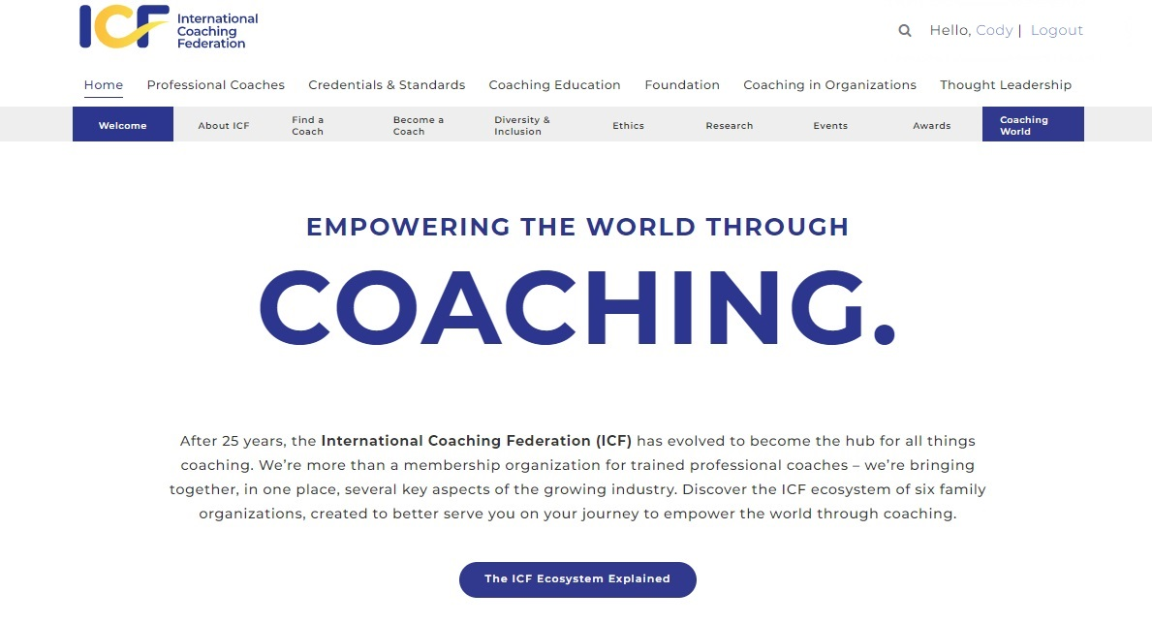
How to locate your Credential Certificate
Sign into your account on the website or if already signed in, click on your name

Slide 2
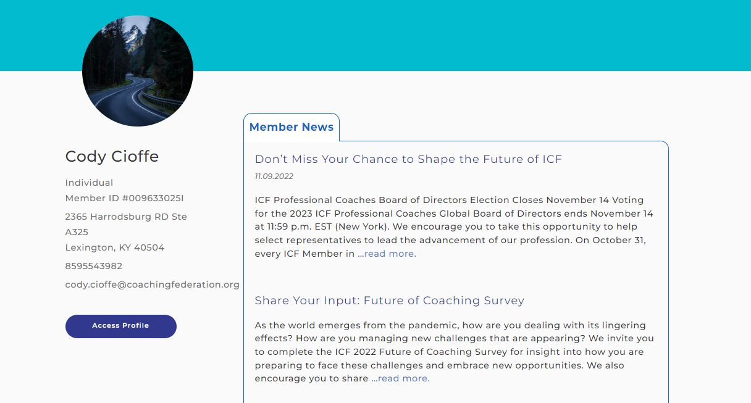
How to locate your Credential Certificate
Click on “Access Profile” ​ to access your profile ​ page.

Slide 3
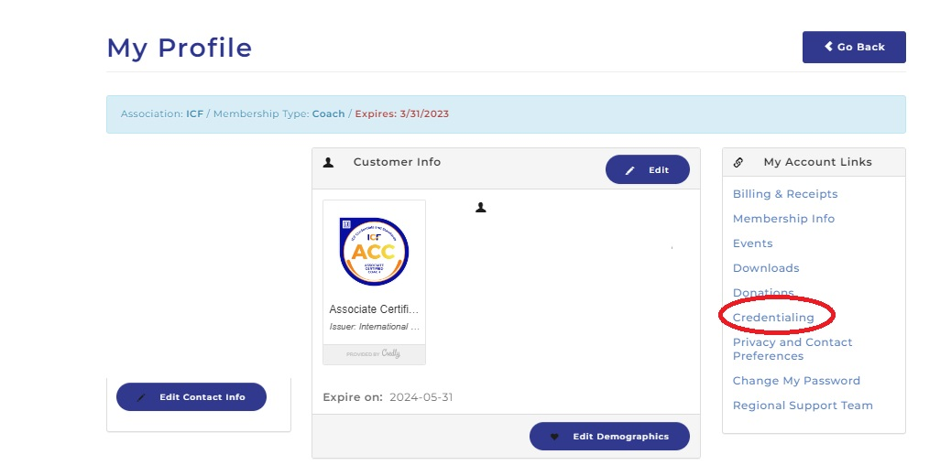
How to locate your Credential Certificate
Click on “Credentialing” ​under My Account Links to access your Credential information.

Slide 4
How to locate your Credential Certificate
Click on “Access Profile” ​ to access your profile ​ page.

Slide 5
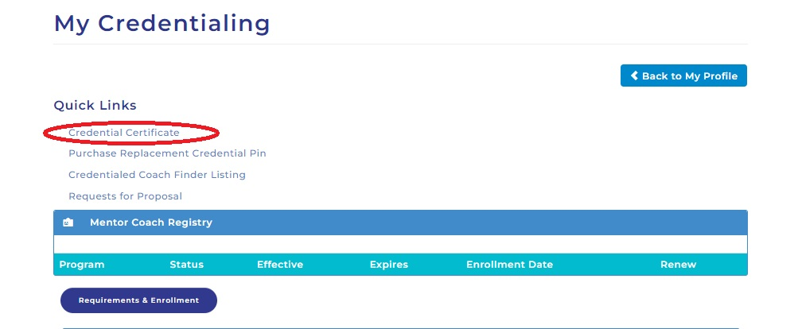
How to locate your Credential Certificate
Under "Quick Links" you will choose the Credential Certificate option and that will allow you to download a PDF version of your Credential Certificate.

Slide 6
How to locate your Credential Certificate
Click on “Access Profile” ​ to access your profile ​ page.

Slide 7
Credentialing Support
EMAIL: support@coachingfederation.org
PHONE: 1-888-423-3131

